Slide 1
Parks AI
Jacob Huber and Hannah Proctor
Notes:
Prepare a brief (7-8 minute) presentation, using PowerPoint for visual aids. Describe…
• the problem you are solving
• the main idea of the “difficult” algorithm (i.e., the one we did not cover in class); showing a small example is often the best way to present the algorithm. The person who did not implement the difficult algorithm is the one who should explain it.
• and your results. Report the percent solved and your other metric (e.g., number of CSP assignments made) for each variation you evaluated (e.g., sizes 100, 1000, 10000, and 100000), using plots that make it easy for the listener to see the main results (e.g., number of nodes grew exponentially w.r.t. the problem size).

Slide 2
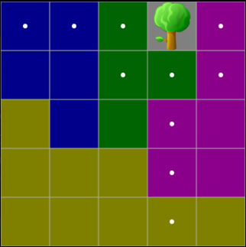
Parks Problem (CSP)
Exactly 1 tree in each row, each column, and each color.
Trees cannot be placed adjacently (all surrounding cells blocked off).
**From Logic Games App**
Notes:
Describe the problem we are solving.

Slide 3
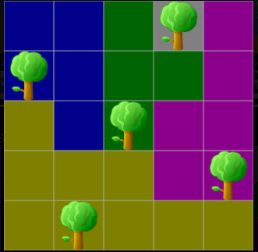
Parks Problem (CSP)
Exactly 1 tree in each row, each column, and each color.
Trees cannot be placed adjacently (all surrounding cells blocked off).
**From Logic Games App**
Notes:
Describe the problem we are solving.

Slide 4
Algorithms
Forward Checking
Forward Checking with Constraint Learning

Slide 5
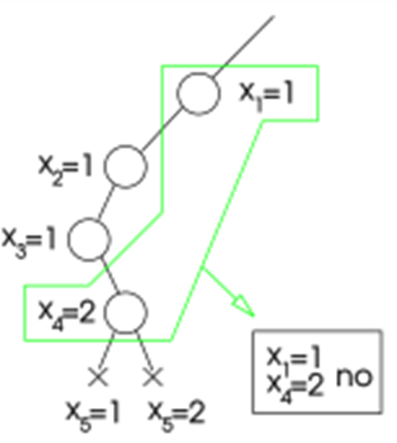
FC with Constraint Learning
Adds complexity by limiting search space.
Additional constraints are "learned" by relating pairs of variables in a subset.
The base of a subset is the last node that has explored more than one child (or the furthest node back).
The end of a subset is a node that has no consistent children.
Notes:
Describe the main idea of the “difficult” algorithm (the one we did not cover in class) by showing a small example. The person who did not implement the difficult algorithm is the one who should explain it.

Slide 6
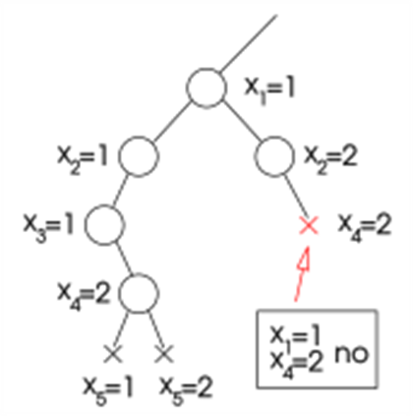
FC with Constraint Learning
Adds complexity by limiting search space.
Additional constraints are "learned" by relating pairs of variables in a subset.
The base of a subset is the last node that has explored more than one child (or the furthest node back).
The end of a subset is a node that has no consistent children.
Notes:
Describe the main idea of the “difficult” algorithm (the one we did not cover in class) by showing a small example. The person who did not implement the difficult algorithm is the one who should explain it.

Slide 7
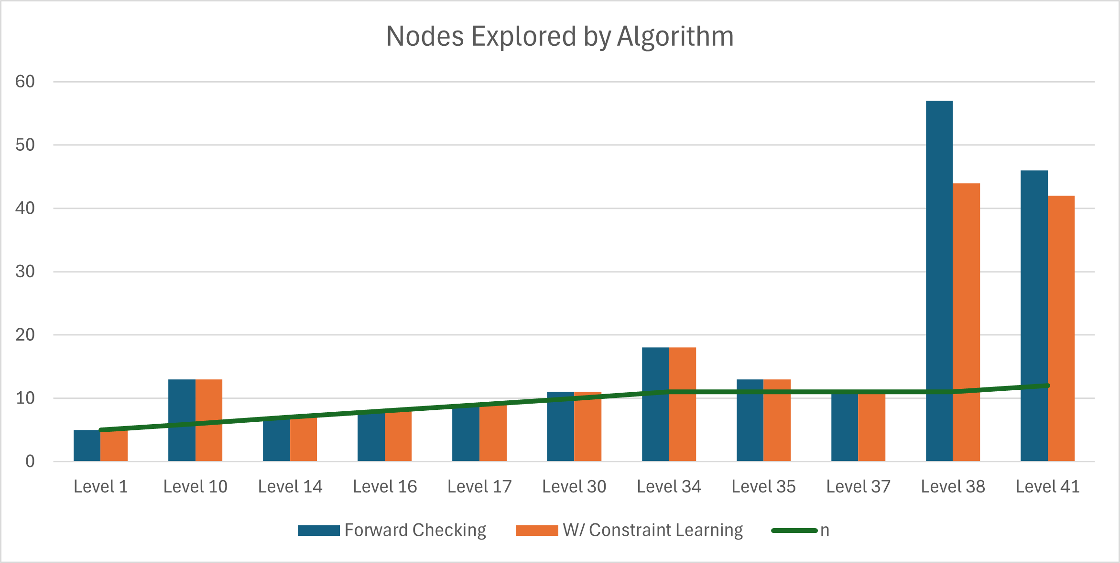
Results
n = board size (5 <= n <= 12)
METRIC: # of nodes explored (i.e., number of trees placed)
Extremely close results...
Minimal backtracking...
Level 38: 57 vs 44
Level 41: 46 vs 42
Notes:
Describe results. Report the percent solved and your other metric (e.g., number of CSP assignments made) for each variation you evaluated (e.g., sizes 100, 1000, 10000, and 100000), using plots that make it easy for the listener to see the main results (e.g., number of nodes grew exponentially w.r.t. the problem size).
Highlight key results and comparisons.

Slide 8
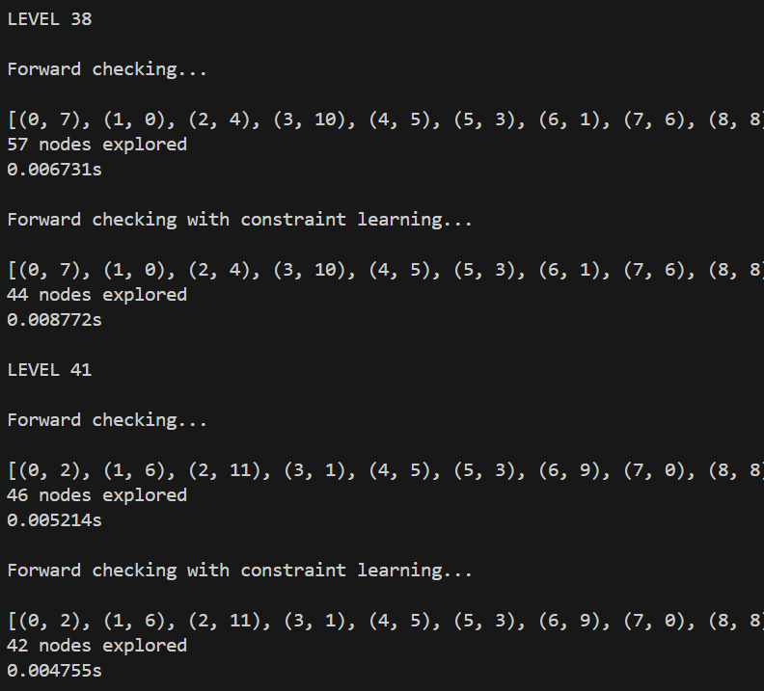
Conclusion
Forward checking works.
Though constraint learning can be more efficient (levels 38 and 41), both algorithms tend to explore the same number of nodes.

Slide 9
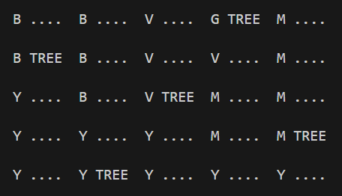
LEVEL 1

Slide 10
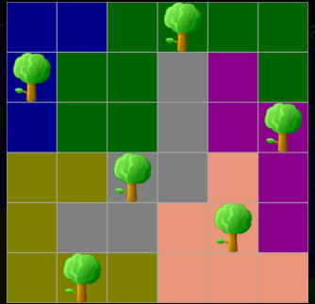
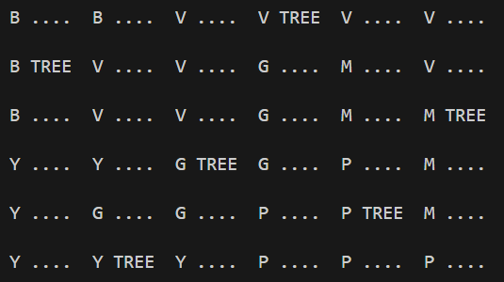
LEVEL 10

Slide 11
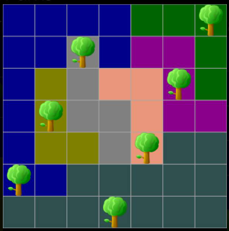
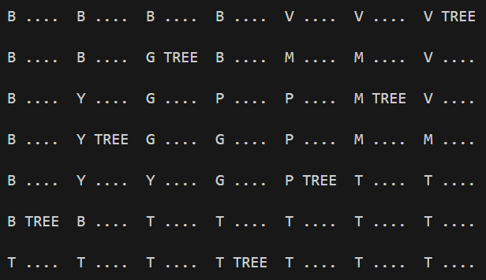
LEVEL 14

Slide 12
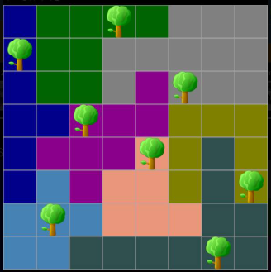
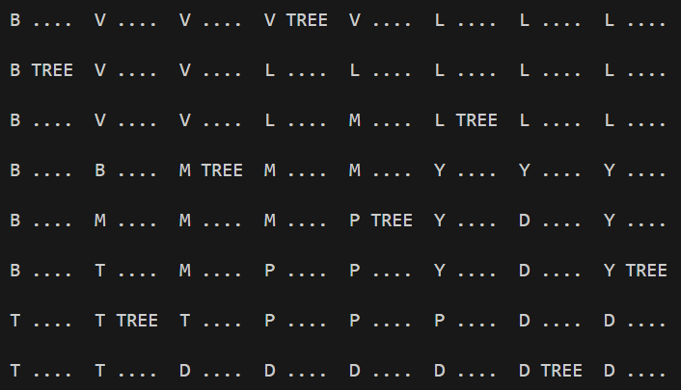
LEVEL 16

Slide 13
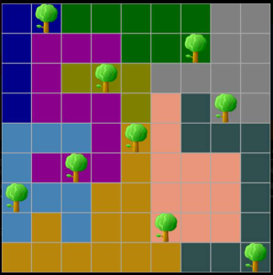
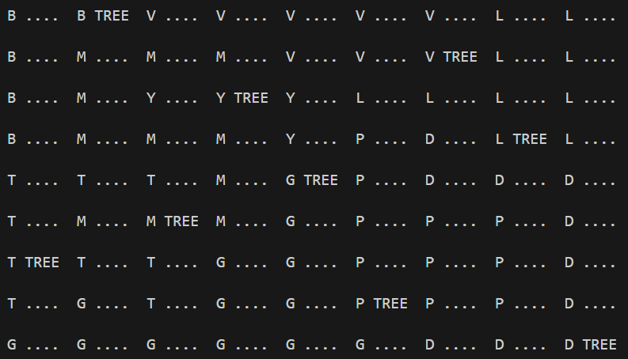
LEVEL 17

Slide 14
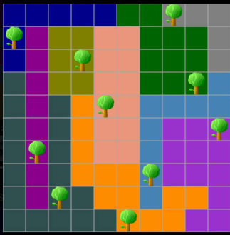
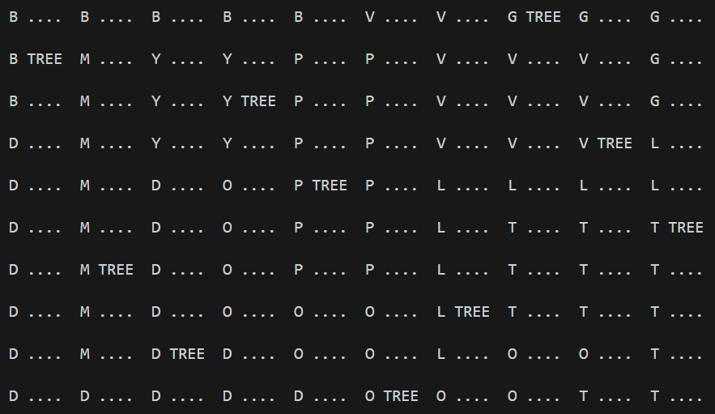
LEVEL 30

Slide 15
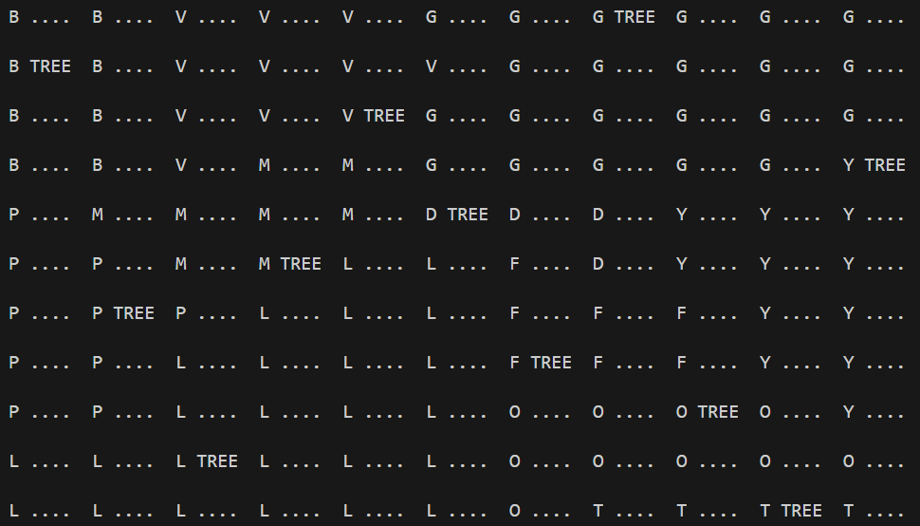
LEVEL 38

Slide 16
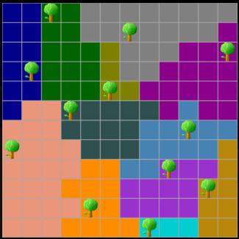
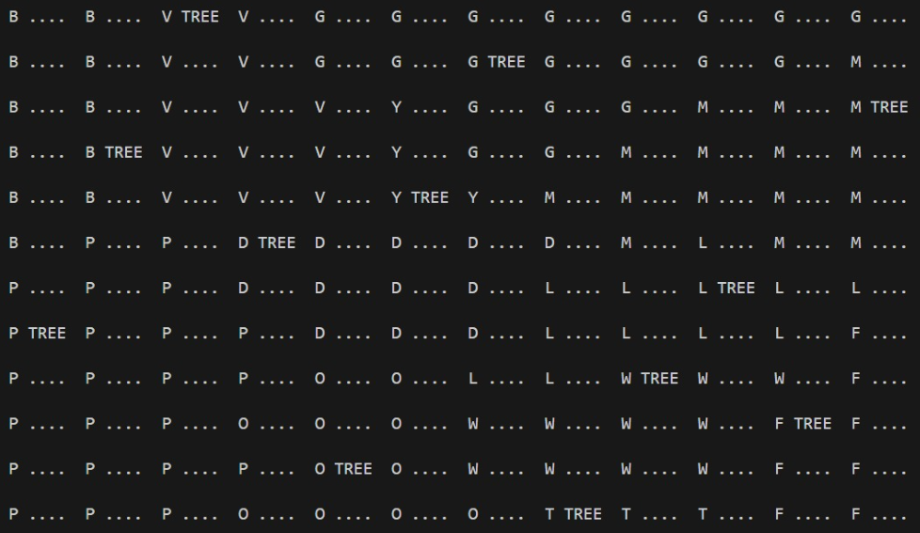
LEVEL 41

